Slide 1
Capstone Engagement
Assessment, Analysis, and Hardening of a Vulnerable System

Slide 2
Table of Contents
This document contains the following sections:
01
Network Topology
02
Red Team: Security Assessment
03
Blue Team: Log Analysis and Attack Characterization
Hardening: Proposed Alarms and Mitigation Strategies
04

Slide 3
Network Topology
‹#›

Slide 4
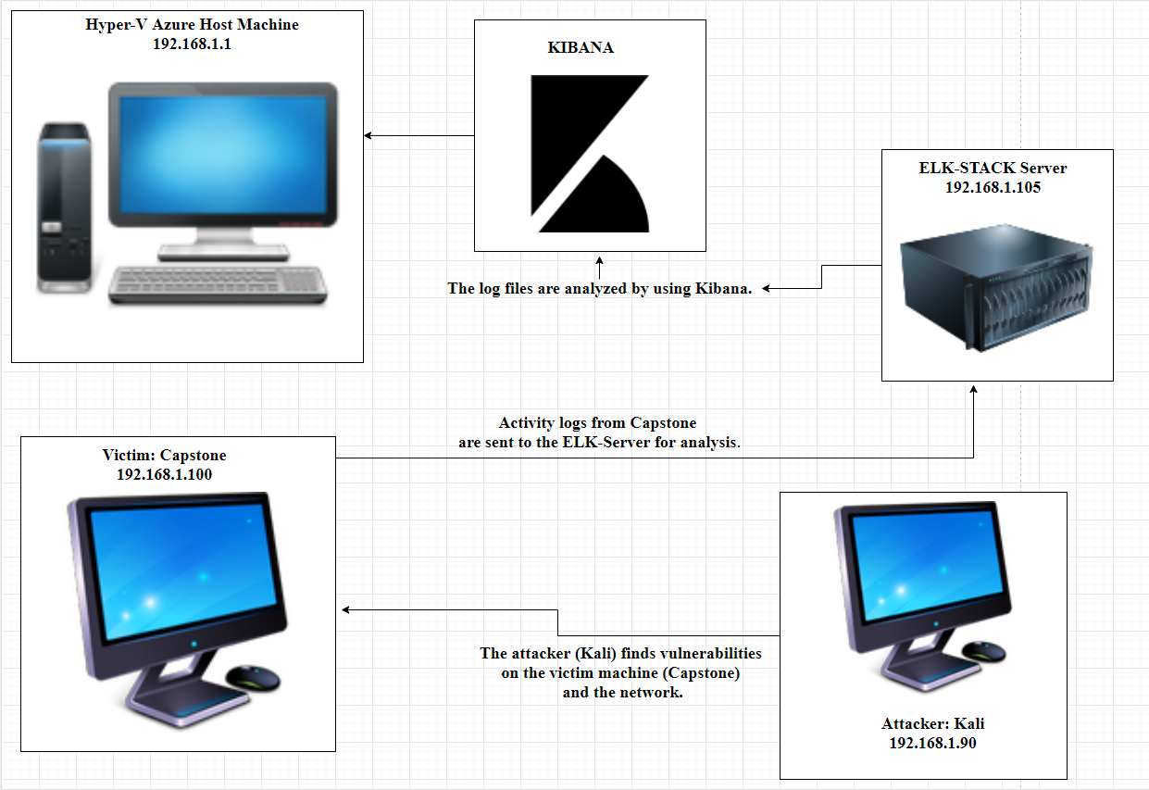
Network Topology
Network
Address Range: 192.168.1.90/24
Netmask: 255.255.255.0
Gateway: 10.0.0.76
Machines
IPv4: 192.168.1.1
OS: Windows 10
Hostname: Hyper-V
IPv4: 192.168.1.90
OS: 5.4.0-kali-amd64
Hostname: Kali
IPv4: 192.168.1.105
OS: Ubuntu-18.0.4.1
Hostname: Capstone
IPv4: 192.168.1.100
OS: 4.15.0-99-generic
Hostname: ELK-Stack

Slide 5

Red Team
Security Assessment
‹#›

Slide 6
Recon: Describing the Target
Nmap identified the following hosts on the network:
Hostname | IP Address | Role on Network
Azure Hyper-V ML-REFVM-684427 | 192.168.1.1 | Azure is the cloud based machine host.
Kali | 192.168.1.90 | The virtual machine which is the attacker.
Capstone | 192.168.1.105 | The virtual machine which is the victim.
ELK-Stack | 192.168.1.100 | Use for monitoring. Data from Capstone is sent here.

Slide 7
Vulnerability Assessment
The assessment uncovered the following critical vulnerabilities in the target:
Vulnerability | Description | Impact
Public access to Port 80 | There is open and unsecured access to anyone | Describe what this vulnerability allows the attacker to do.
Ability to find passwords through Brute Force attacks. | Attacker can use numerous names and password combinations to gain access | Easy access by using common password lists (we used rockyou.txt) and program slike Hydra and Jack The Ripper.
Weak passwords and usernames. | Short and simple names and passwords are easy to crack through social engineering. | Ties in with the vulnerability to brute force attacks. Gives outsiders access to files/folders.
LFI Vulnerability (Local File Inclusion) | An attack which allows someone to trick a web application into exposing or running files. | This can cause access to sensitive information. It can allow malicious activity which can disrupt business.

Slide 8
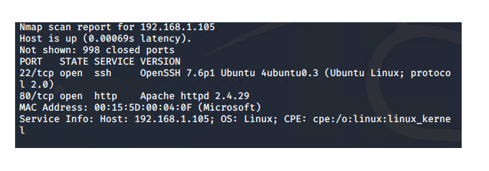
Exploitation: [Nmap Port 80 Access]
01
02
Tools & Processes
Nmap was used to scan the network range and find the IP and ports:
Nmap 192.168.1.90/24
Achievements
I was able to find 4 hosts that were running. Port 22 and 80 were open on the Capstone host.

Slide 9
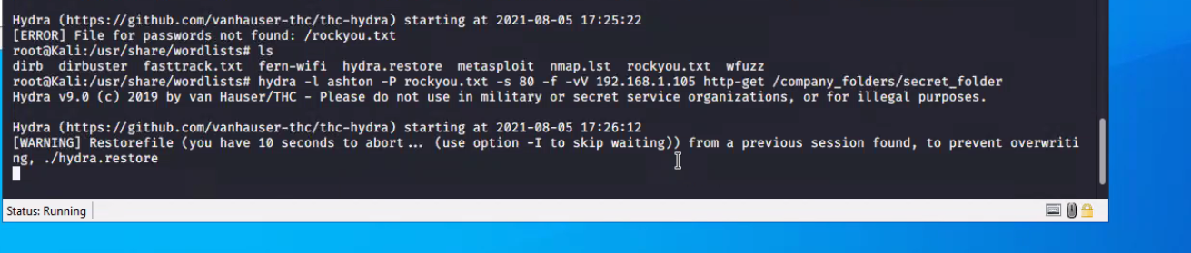
Exploitation: [Hydra]
01
02
Tools & Processes
I used Hydra to brute force attack Ashton’s login.
Achievements
What did the exploit achieve? For example: Did it grant you a user shell, root access, etc.?

Slide 10
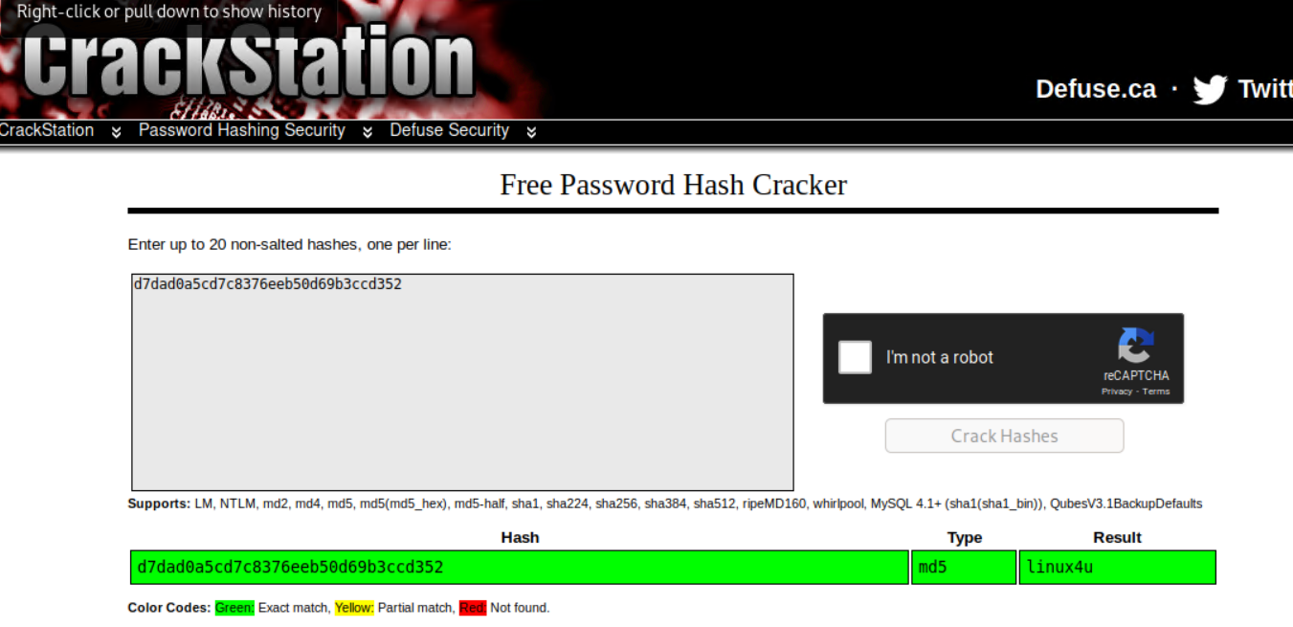
Exploitation: [Hash Password]
01
02
Tools & Processes
Used crackstation.net to find Ryan’s password from the hash we found.
Achievements
We discovered that Ryan’s password was linux4u.

Slide 11
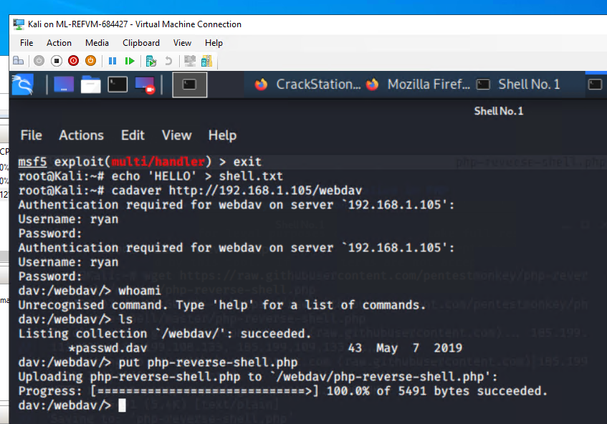
Exploitation: [PHP Reverse Shell]
01
02
Tools & Processes
Used cadaver to deliver a php reverse shell into Capstone.
Achievements
Obtained root access to the Capstone machine.

Slide 12

Blue Team
Log Analysis and Attack Characterization
‹#›

Slide 13

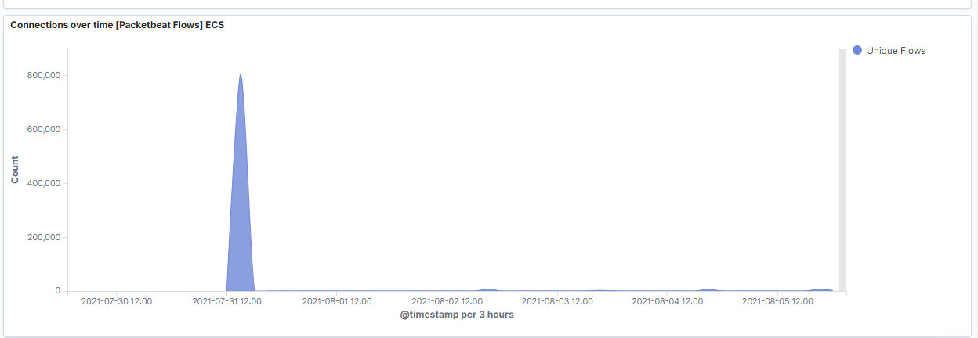
Analysis: Identifying the Port Scan
What time did the port scan occur? 3:00pm
How many packets were sent, and from which IP? 803,980
What indicates that this was a port scan? The sudden peak in network traffic.
.

Slide 14
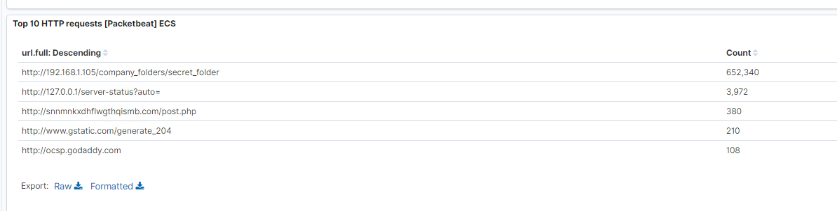
Analysis: Finding the Request for the Hidden Directory
What time did the request occur? 4:00pm
How many requests were made? 652,340
Which files were requested? Secret Folder file which contained password information for Ryan

Slide 15
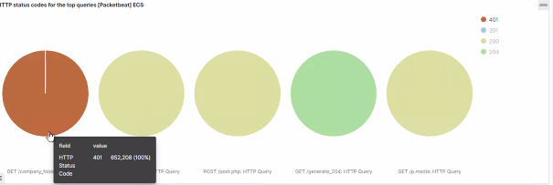
Analysis: Uncovering the Brute Force Attack
How many requests were made in the attack? 26
How many requests had been made before the attacker discovered the password? 652,208

Slide 16
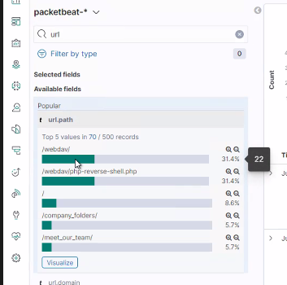
Analysis: Finding the WebDAV Connection
How many requests were made to this directory? 22
Which files were requested? php.reverse.shell.php

Slide 17
Blue Team
Proposed Alarms and Mitigation Strategies
‹#›

Slide 18
Mitigation: Blocking the Port Scan
What kind of alarm can be set to detect future port scans?
A TCP scan which alerts when 1000 TCP connections have occurred at any time.
What configurations can be set on the host to mitigate port scans?
Install Intrusion Detection Systems and Intrusion Prevention Systems.
Run regular hourly port scans to detect and audit.
Keep the firewall up to date and patched.

Slide 19
Mitigation: Finding the Request for the Hidden Directory
What kind of alarm can be set to detect future unauthorized access?
An alert which goes off when 5 or more requests are made per hours.
An alert that triggers whenever an outside IP attempts access.
What configuration can be set on the host to block unwanted access?
Data should be encrypted.
Use a private network/vpn and only allow those addresses access.

Slide 20
Mitigation: Preventing Brute Force Attacks
What kind of alarm can be set to detect future brute force attacks?
An alert which triggers when a HTTP code of 401 occurs.
What threshold would you set to activate this alarm?
The alarm would trigger after fr unsuccessful attempts.
What configuration can be set on the host to block brute force attacks?
Account is locked for 30 minutes after 3 unsuccessful attempts.
Mandatory password requirements which contain letters, numbers, and symbols.
Character length of 8 or more.
Secondary form of verification such as a pin.

Slide 21
Mitigation: Detecting the WebDAV Connection
What kind of alarm can be set to detect future access to this directory?
An alert which triggers when there is an HTTP GET request which is not one of the authorized IP addresses.
What configuration can be set on the host to control access?
Create a list of trusted and authorized IPs which is updated 2-3 times a year.

Slide 22
Mitigation: Identifying Reverse Shell Uploads
What kind of alarm can be set to detect future file uploads?
Alert that is triggered whenever a file is added to the /WebDAV folder.
Alert which is triggered when there is traffic accessing the 4444 port in real time.
Alert which is triggered when HTTP Put requests are made in real time.
What configuration can be set on the host to block file uploads?
Block IP Address which are not trusted.
Whitelist allowed file types.
Antivirus software should scan all uploaded files.
Files uploaded must be a set length and size.

